Slide 1

NEXT LEVEL GAMING
& ESPORTS ARENA
GLOBAL VENUE MASTERPLAN
PHASE 2026
PRESENTED BY
DATE
CLASSIFICATION
Arena Operations Board
OCTOBER 27, 2026
STRATEGIC PROPOSAL
NEXT LEVEL ESPORTS
ARENA ARCHITECTURE & TOURNAMENT FACILITY PROTOCOL V4.0

Slide 2
CONTENTS
Next Level Gaming & Esports Arena
01
Next Level Gaming & Esports Arena
08
Opening the App - Home Screen
14
The Website Homepage
02
Meet the Team: Khwezi Qakosha
09
Browsing the Packages
15
More Than a Place to Play
03
What is the Arena?
10
Making a Quick Booking
16
Packages and Events Detail
04
The Problems We Found
11
Events and Tournaments
17
The Booking Journey
05
The Solution: Website + App
12
Tracking and Loyalty
18
Getting in Touch
06
The Look and Feel
13
Meet the Team: Tshegofatso Maphosa
19
Project Wrap-up
07
Meet the Team: Oratile Dire

Slide 3



MODULE XHAW5112 • WORK INTEGRATED LEARNING
Client collaboration under Jason Naidoo driven by Group TWC, dedicated to competitive esports systems and focused on tournament play.
Next Level Gaming &
Esports Arena
Khwezi Qakosha
Tshegofatso Maphosa
Oratile Dire
Student ID: ST10510557. Core project contributor directing esports arena operations, competitive tournament flow, and interactive engagement structures.
Student ID: ST10538773. Lead functional strategist executing player management dynamics, bracket organization, and gaming event optimization.
Student ID: ST10520970. Key technical member coordinating operational delivery, arena ecosystem coordination, and seamless client requirements.

Slide 4
SPEAKER 1 SECTION: THE BIG PICTURE
Meet the Team: Khwezi Qakosha
STRATEGIC VISION
EXECUTION ROADMAP
Next Level Gaming & Esports Arena
Digital Ecosystem & Development
Establishing arena branding and market positioning
Architecting unified website and arena app solutions
Driving multi-channel audience engagement initiatives
Strategic branding and development goals
Aligning competitive vision with modern esports venue design
Deploying integrated player registration and ticketing workflows
Coordinating key speaker narratives and project launch scope
Scaling technical infrastructure for community engagement

Slide 5


NEXT LEVEL GAMING
Next Level Gaming & Esports Arena
OVERVIEW & PROFILE
What is the Arena?
Founded
City
Prime Location & Launch
2023
Johannesburg
Located in Johannesburg, opened in 2023 by Jason Naidoo as a premiere gaming facility.
Founder
Venue Type
Esports & Gaming Hub
Jason Naidoo
Esports Hub
A premier destination for everyday casual gaming sessions and competitive esports tournaments.
Community & Private Events
Perfect venue tailored for birthday parties, school outings, and corporate team-building.
Dedicated to delivering world-class digital entertainment, community tournaments, and versatile group event packages in South Africa.

Slide 6
NEXT LEVEL GAMING & ESPORTS ARENA
The Problems We Found
CUSTOMER JOURNEY
AUDIENCE SEGMENTS
COMPETITIVE PLAY
Navigation & Booking
Different Group Needs
Tournament Tracking
Booking is messy with poor navigation for new visitors
Families want quick fun and frictionless booking access
Missing tournament schedules across active arena brackets
Lack of segment-specific info across entry portals
Schools and institutions need tailored official quotes
Pros struggle with unclear and fragmented sign-up rules
High drop-off rate during checkout and reservation steps
One-size-fits-all onboarding fails both user groups
Severe delays in roster validation and entry confirmations

Slide 7

WEB PORTAL
MOBILE APP
MOBILE APP
MOBILE APP
Lead Acquisition
Quick Bookings
Status Tracking
Player Rewards
Helps new visitors discover arena & request quotes
Seamless seat reservation for returning players
Tier points, tournament badges & exclusive perks
Real-time arena station & hardware availability
NEXT LEVEL GAMING & ESPORTS ARENA
The Solution: Website + App
We built a dual-system approach. The Website helps new people discover the arena and request quotes easily, while the App helps returning players book fast, check status, and earn rewards.

Slide 8
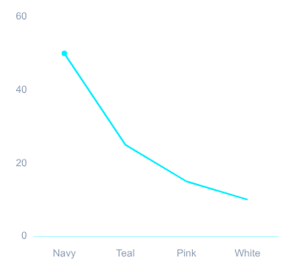
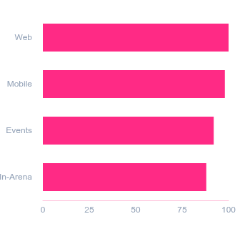
BRAND IDENTITY & AESTHETICS
4
Core Colors
100%
Omni-Channel
The Look and Feel
Palette Distribution (%)
Interface Adoption Rate (%)
A custom logo mixes a controller shape with arena ring lines, establishing our bold presence across competitive gaming culture.
Midnight Navy, Electric Teal, Pulse Pink, and Cloud White provide high-contrast legibility and vibrant modern gaming energy across dark surfaces.
paired with Midnight Navy, Electric Teal, Pulse Pink, and Cloud White for consistent web and mobile branding across digital platforms.

Slide 9




NEXT LEVEL GAMING & ESPORTS ARENA
Speaker 2 Section: The App Walkthrough. Live-style demonstration of the mobile interface.
Meet the Team: Oratile Dire
Speaker & Role Overview
Booking Flow Walkthrough
Speaker 2: Oratile Dire (ST10520970) takes over for Section 2 with an interactive mobile app walkthrough demonstration.
Stepping screen by screen through booking interfaces and station selections.
Presents an end-to-end user journey across the arena digital touchpoints.
Demonstrating real-time rig availability, calendar locks, and reservations.
Packages & Tiered Passes
Loyalty & Rewards Engine
In-depth navigation through dynamic hourly passes and event bundles.
Unlocking gamified tier milestones, arena tokens, and custom user perks.
Highlighting seamless checkout workflows and team package upgrades.
Showcasing community leaderboard sync and live member benefits.

Slide 10





NEXT LEVEL GAMING & ESPORTS ARENA
Opening the App - Home Screen
Mobile Interface Overview
HERO SECTION
CALL TO ACTION
INTERFACE NAVIGATION
Welcome Message
Instant Access
Bottom Navigation
Ora greets every player and team entering the platform with a clear high-energy invitation to competition.
Primary engagement triggers positioned upfront to convert visitors into booked arena sessions.
A structured dock offering uninterrupted 5-tab reach across full facility services.
Tap "Browse packages"
Home: Active dashboard & live feeds
Packages: Rig & tier pricing tiers
DISPLAY TEXT
Events: Brackets, LANs & showmatches
"Your next level starts here."
or "Request a quote"
Book: Station & room reservation
My Bookings: Passes & schedule details
KEY HEADLINE
ACTION TARGET
DOCK DEPTH
Ora
App Experience
2 CTA
Direct Actions
5 Tabs
Full Navigation
Personalized greeting for arena visitors
Seamless tournament & squad reservation
Standardized bottom dock architecture
BOTTOM NAVIGATION BAR ARCHITECTURE:
Home
Packages
Events
Book
My Bookings

Slide 11

Individual Gaming Session starting from R150
NEXT LEVEL GAMING & ESPORTS ARENA
Browsing the Packages
Friends & Family group access for R1,200
Custom School or Club bookings with full details
View of the Packages screen. Explore tailored rates for solo players, social groups, and custom community bookings.
Dedicated arena configurations for competitive esports

Slide 12


NEXT LEVEL GAMING & ESPORTS ARENA
A seamless walkthrough of our live estimate tool designed to deliver prompt, effortless pricing and seat reservations.
Making a Quick Booking
1. Select Package
2. Contact Details
3. Instant Cost
Tap a package to open the instant estimate calculator and explore customized esports arena options tailored to your party.
Just enter your contact details into the prompt fields to set up your booking profile and secure access before submission.
The application automatically calculates your total cost on the spot, keeping the booking process fast, transparent, and easy.

Slide 13
NEXT LEVEL GAMING & ESPORTS ARENA
Events and Tournaments
EVENT TRACK 01
EVENT TRACK 02
Community Showdown
Weekend Tournament
Dedicated Events screen layout for grassroots play
Weekly schedule for high-tier Weekend Tournament series
Competitive gamers find Community Showdown listings
Tap Register Interest to join organized esports play directly
Structured brackets and real-time open division matches
Fast registration flow tailored for competitive gamers
Direct pathway into organized competitive circuits
Live broadcast streams and arena leaderboards integration
REGISTER INTEREST
REGISTER INTEREST

Slide 14
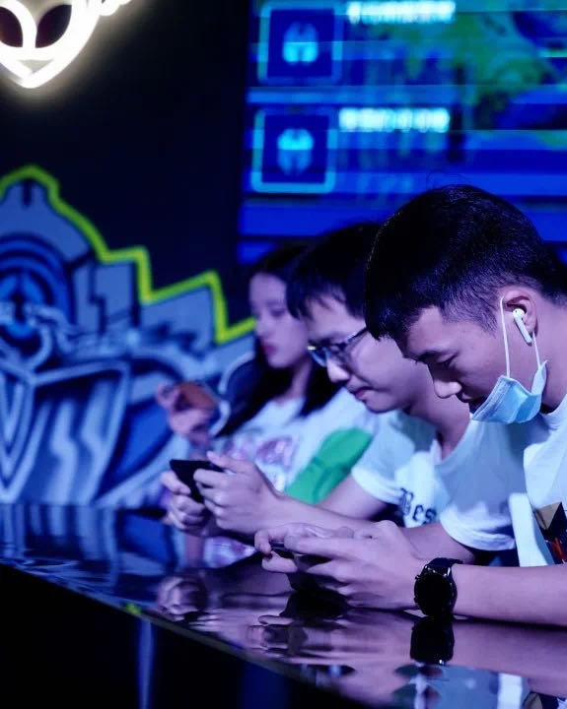



PLAYER EXPERIENCE
Tracking and Loyalty
Booking Status Tracker
Track your arena session live: Received, Quoted, Confirmed, and Completed statuses at a glance.
Tiered Loyalty System
Save more as you play: get 5% off after 2 visits, 10% off after 3, and 15% off for regular players.
Instant Updates & Sharing
Receive prompt push reminders and make sharing match plans with squad friends completely seamless.

Slide 15
SPEAKER 3 SECTION • TSHEGOFATSO MAPHOSA
Meet the Team: The Website Walkthrough
LIVE PLATFORM DEMO
EXPERIENCE & PACKAGES
BOOKING PORTAL
Brand & Joburg Arena Identity
Discovery & Event Offerings
Schedules & Seamless Reservations
Guided walkthrough led by Tshego
Explore customized gaming packages
Real-time arena schedule checks
Distinct from Next Level Games
Competitive esports setup details
Submit instant player bookings
Dedicated Joburg gaming hub presence
Tailored social & group passes
Frictionless digital reservations

Slide 16
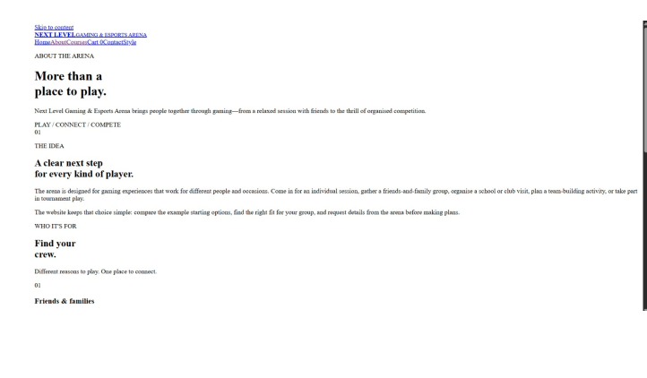
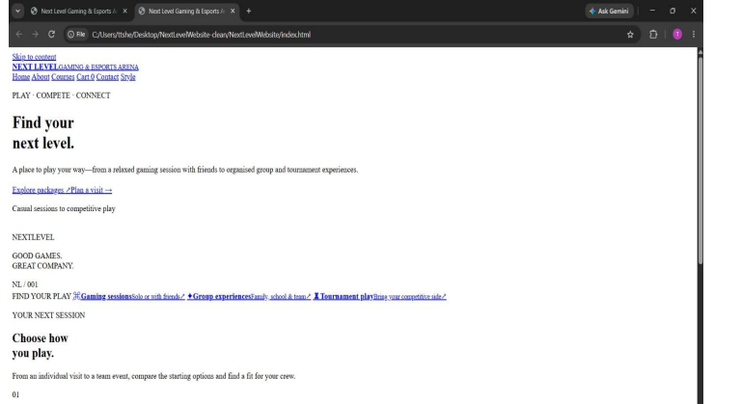
THE WEBSITE HOMEPAGE · WALKTHROUGH
EXPLORE PACKAGES
PLAN A VISIT
Find your next level — Play. Compete. Connect.
homepage_hero.png
homepage_highlights.png
CASUAL PLAY
GROUPS
TOURNAMENTS
HUB LIVE
Casual gaming sessions built for social connection.
Tailored group packages designed for teams, parties & esports events.
Live esports tournament updates and real-time rankings.
Real-time arena booking & instant community match finder.

Slide 17
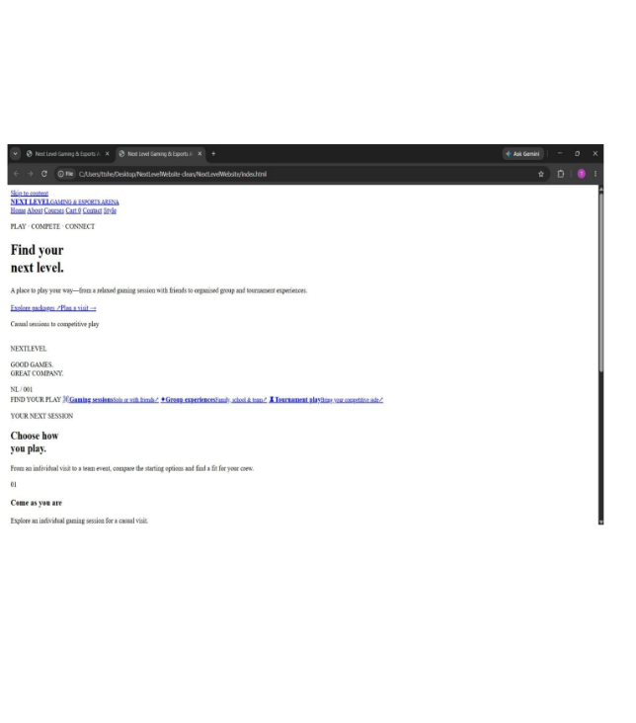
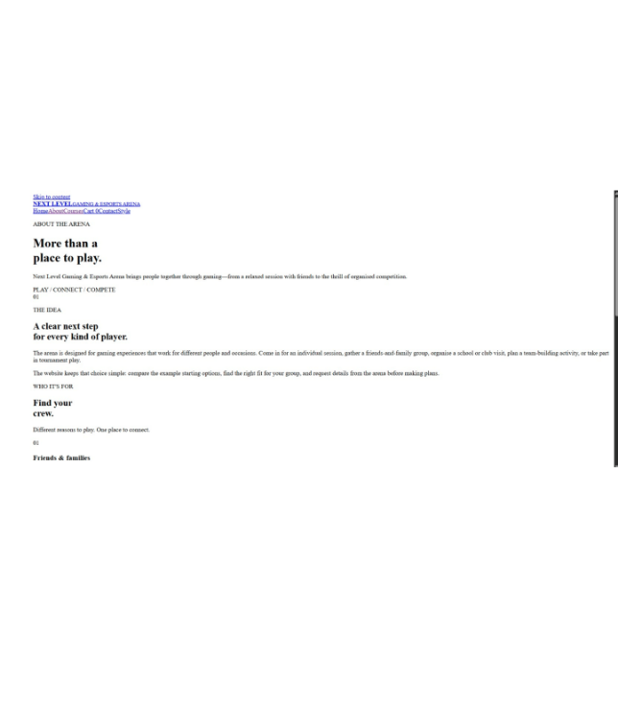
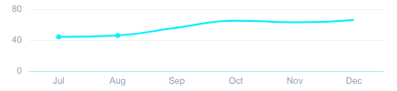
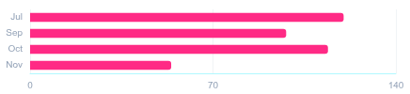
ABOUT THE ARENA • WALKTHROUGH
Our About page highlights our mission: the arena is a social space fostering Joburg's gaming community. It serves as a vital hub for South African players, welcoming casual friends and competitive teams.
More Than a Place to Play
WEBSITE INTERFACE OVERVIEW
About Page Walkthrough
about/arena-overview
about/community-hub
100%
Social & Inclusive
Community Growth & Engagement
Designed for local players to connect offline, celebrate team victories, and build lasting friendships.
All Ranks
Competitive Arena
From Grassroots to Pro Teams
Accommodating casual weekend groups and ranked squads aiming for regional championships.

Slide 18




NEXT LEVEL GAMING & ESPORTS ARENA
Deep dive into the web listings with verified breakdowns across tier durations, tournament rules, and gear setups.
Packages and Events Detail
Duration & Group Matrix
Rig Gear & Infrastructure
Standard squads accommodate 5 to 10 players across flexible 2-hour and 4-hour competitive blocks.
Equipped with flagship RTX 4090 rigs, 360Hz displays, and ultra-low-latency mechanical switch interfaces.
Full arena LAN lockouts support up to 50 participants with extended 8-hour continuous tournament slots.
Includes dedicated symmetric gigabit lines, isolated team audio channels, and ergonomic pro seating.
Upcoming Event Regulations
Deadlines & Web Listings
Strict compliance with double-elimination formats, standard anti-cheat protocols, and referee server checks.
Roster verification locks 72 hours before opening qualifiers; late entry submissions are not permitted.
Player eligibility requires valid team rosters submitted 48 hours prior to bracket generation and live seeding.
Compare package duration, gear, and group sizes with clean tables, while checking registration deadlines and rules for upcoming esports events.

Slide 19
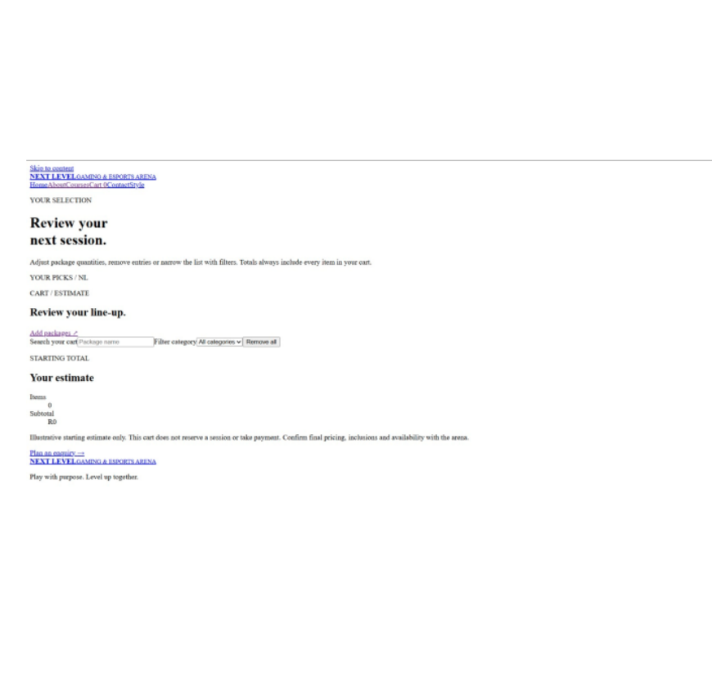
NEXT LEVEL GAMING & ESPORTS ARENA
The Booking Journey
LIVE FLOW UI WALKTHROUGH
Seamless end-to-end reserve experience from game discovery to live match confirmation
PHASE 01 • DISCOVERY
PHASE 02 • ESTIMATE
PHASE 03 • CONFIRMATION
Website Preview • Booking Flow
walkthrough.png
Step-by-Step Path
Review Estimate
Request Received
1
Home & Browse
Package
Pro Bay
•
Confirmed #NL-9402
Tournaments & zones
Duration
3h (5P)
Venue reserved. Dispatch synced with moderator queue.
2
Pick Experience
Rate
$45/hr
PC rig or console pod
Total
$135.00
Check-in codes & updates tracked in My Bookings.
3
Set Details
Instant calculation with dynamic pricing protection.
Slots & peripherals
ENTRY STAGE
READY
POST-BOOKING
< 2 min setup
Price Locked
Passport Synced
UI Screenshot: Dedicated Online Booking Interface
Interactive Flow
Next Level Esports Arena • Player & Squad Self-Service Portal
Journey Flow: 100% Automated Workflow

Slide 20
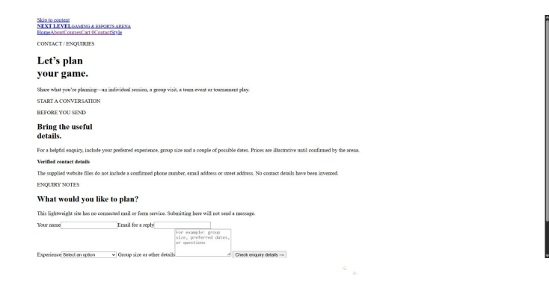
NEXT LEVEL GAMING & ESPORTS ARENA
Fill in your name, email, experience type, and group size. Sample rates from R150 to R4,500, then hit "Check Details".
Getting in Touch | Package Examples & Enquiry Form
Package Examples & Tier Rates
Interactive Enquiry Booking Form
STANDARD ENTRY
R150
SMALL SQUAD
R1,200
CAMPUS BOOKING
R2,500
FULL TIER
R4,500
Individual Session
Family Package
School Tournament
Corporate Arena Hire

Slide 21



NEXT LEVEL GAMING & ESPORTS ARENA
Summary of digital products crafted for esports community engagement and modern venue reservation experience.
Project Wrap-up
Platform Ecosystem
Brand & Experience
Status & Appreciation
We built a website for new fans and an app for regulars, tailored specifically for comprehensive audience reach.
Clean branding and a smooth booking journey created for Jason Naidoo, ensuring seamless arena interaction and clear user navigation.
Note: these are prototypes, not live systems. Thank you for your time and continued collaboration!

